Slide 1
Up-A-Creek Robotics Team Training

Slide 2
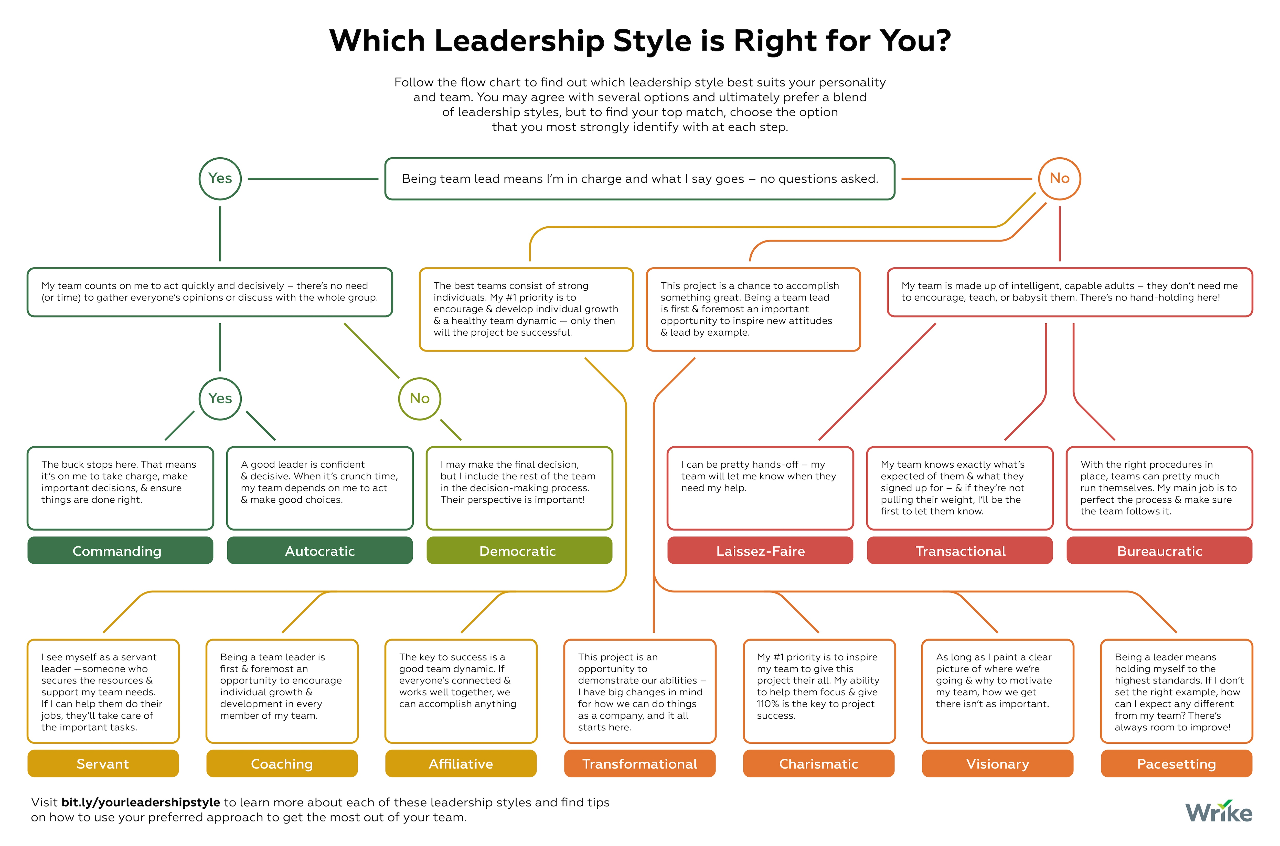
Leadership
Notes:
We are going to discuss leadership.
Not everyone here is in a leadership position on the team but we can all benefit from being on the same page about what is expected in a student leader on the team.
There are many theories of leadership and defined leadership styles, but we aren’t running a start up or an international conglomerate, we are at a high school robotics team.
And student leads are peers who still have both technical and leadership skills to learn.
So we will make it simple to identify what type of leader fits best with the team.

Slide 3
Leadership
Notes:
We are going to discuss leadership.
Not everyone here is in a leadership position on the team but we can all benefit from being on the same page about what is expected in a student leader on the team.
There are many theories of leadership and defined leadership styles, but we aren’t running a start up or an international conglomerate, we are at a non-profit high school robotics team.
And student leads are peers who still have both technical and leadership skills to learn.
So none of these leadership styles are appropriate.

Slide 4
Student leadership at UACR
Focus on enabling sub-team members (#1 priority)
Make sure the team members have the materials, knowledge, skills they need to be successful.
Make sure they have something to do.
Lead by example
Be a role model for other sub-team members
Continue learning
Set a positive tone
Assume the best not the worst of others
If there is a problem, consult mentors.

Slide 5
Systems Level Thinking
Each sub-team is part of a larger organization. Building a complex machine requires understanding how the work of each sub-team comes together. Sub-team leads need to understand where the sub-team fits in the context of the larger team.
As a lead, you need to know what needs to get done and when it needs to get done and to succinctly convey that to the team.
Ensure it gets done. The sub-team lead is responsible for making sure the job gets done.
Communication between sub-teams is key.

Slide 6
Traits of a good leader
Don’t micromanage
Trust but verify
Subteams have the autonomy to accomplish goals in the way they need.
Teach
It is a leads responsibility to pass knowledge to the next generation of students.
Be a good listener. Communication is as much about listening as it is about speaking. Listen to seek understanding not to find points to argue about.

Slide 7
A mental image of this leadership style
https://youtu.be/EFge-nS50GY
Notes:
https://youtu.be/EFge-nS50GY
The leader is in the pilot car, making sure the way is clear.
The lead didn’t just jump in the car and start down the road. Work was done in advance to make sure the truck would make it to its destination.
The lead has checked the overpass heights to make sure the truck can pass.
The lead is looking out for the safety of the wide-load truck (subteam) and others on the road (the rest of the team and other teams).
https://www.popularmechanics.com/space/telescopes/news/a28416/telescope-mirrors-shipped-cross-country/
https://youtu.be/EFge-nS50GY

Slide 8
Some examples (1 of 3):
One of your subteam members spends their time socializing instead of working on the tasks at hand. How should you proceed?
Notes:
Find out why the person isn’t working on tasks. Do they have something to do? Do they know how to do it? What is the root cause of the issue? Listen carefully.
Make positive suggestions
Be careful of your tone – don’t sound accuratory
Quiz questions:
1. It is time to clean up and it has been announced so everyone can hear and no one in your subteam is helping. Do you:
Shout loudly that it is time to clean up
Have an in depth conversation with each person as to why they aren’t cleaning up
Find a couple of people and recruit them to start cleaning with you. [ Debrief: we are not bossy. Lead by example]
2. One of your subteam members spends their time socializing instead of working on the tasks at hand. How should you proceed:
Ask them in front of everyone else to stop socializing and get to work.
Find out if they don’t understand what is needed to do the task
Ask a mentor to help [ b or c are good. We don’t publicly shame someone]
2. It is the beginning of the build season and we are having lunch on Saturday. You notice that one of the new students is sitting alone
Go join your friends because someone else will sit with them
Join them and ask them what they think of the game this year
Find their subteam lead and tell that person to sit with them [ b. It is everyone’s job to set a friendly tone. There are not barriers to subteams. Their subteam lead might be busy with something and not able to sit with them.] See it isn’t that hard.

Slide 9
Some examples (2 of 3):
It is time to clean up and it has been announced so everyone can hear and no one in your subteam is helping. What do you do?
Notes:
Don’t be bossy. Make sure everyone knows what needs to be done.
Lead by example. Find friends to help you clean up.

Slide 10
Some examples (3 of 3):
It is the beginning of the build season and we are having lunch on Saturday. You notice that one of the new students is sitting alone. Is there something you should do?
Notes:
Join the new student, engage them in conversation, find common ground. Ask them about themselves.

Slide 11
It isn’t Rocket Science!
While it isn’t Rocket Science, sometimes getting things right between people is hard.
101 for working with people.
Communicate clearly. People can’t read your mind.
Be open and honest.
Take individual responsibility. If you mess up, own it and try to make it right.
Assume others have the best of intentions
When in doubt, ask a mentor. And anyone can ask a mentor whenever they have a question.

Slide 12
Conflict Resolution
Conflict can create barriers to communication
But communication is key to resolving conflict.
When discussing a emotionally-charged conflict, it is good to have an independent person mediate (like a mentor).
Be open, honest and empathetic (these can be hard if your feelings are hurt).
Phrase the issue in terms of how it made you feel.
For example, ‘When you finished the assembly I had been working on, it made me upset because I wanted to complete it’
Look for common ground
Strive for win-win solutions
Listen to what each side needs
And even if there isn’t a win-win solution, future conflicts could be resolved by communicating.

